Slide 1
Intro to Neural Nets
Course Logistics and Introduction

Slide 2










About Me

Slide 3

Today’s Agenda
1. COURSE LOGISTICS
Website, schedule, grading and evaluation criteria.
Course textbook, lecture format, etc.
2. INTERESTING USE CASES
Frivolous, academic, and practically useful.
A recent failure, and societal concerns.
3. QUICK INTRODUCTION
What is a neural network?
How does it work?

Slide 4
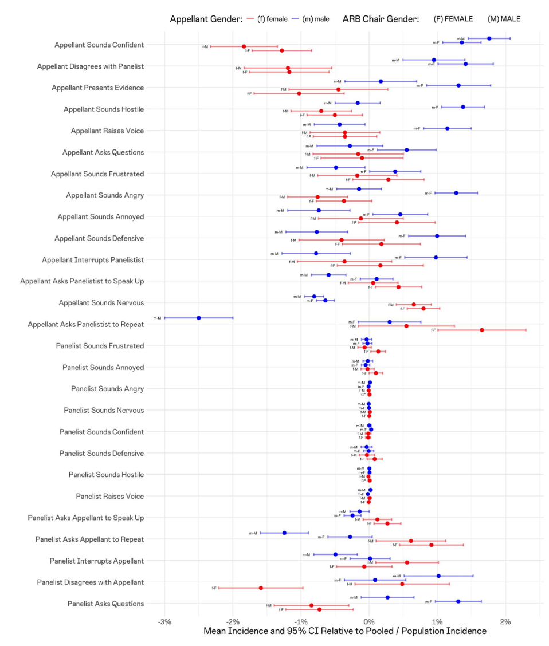
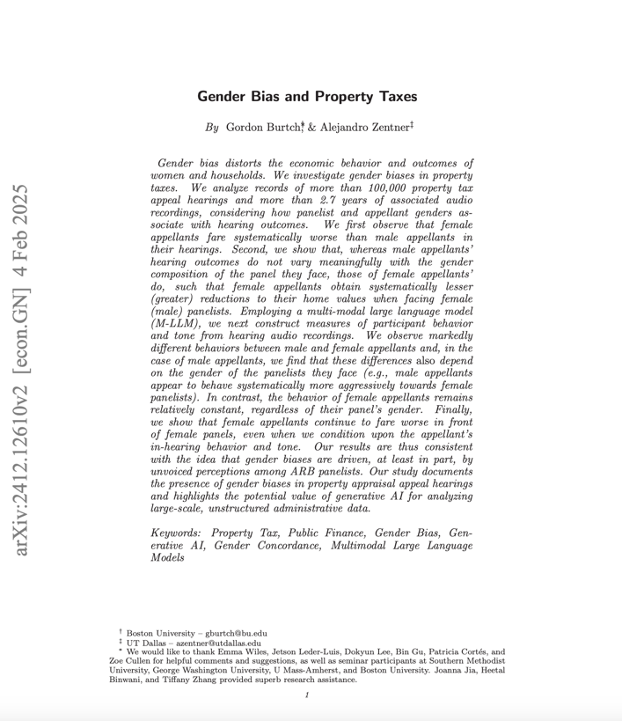
Some Research

Slide 5
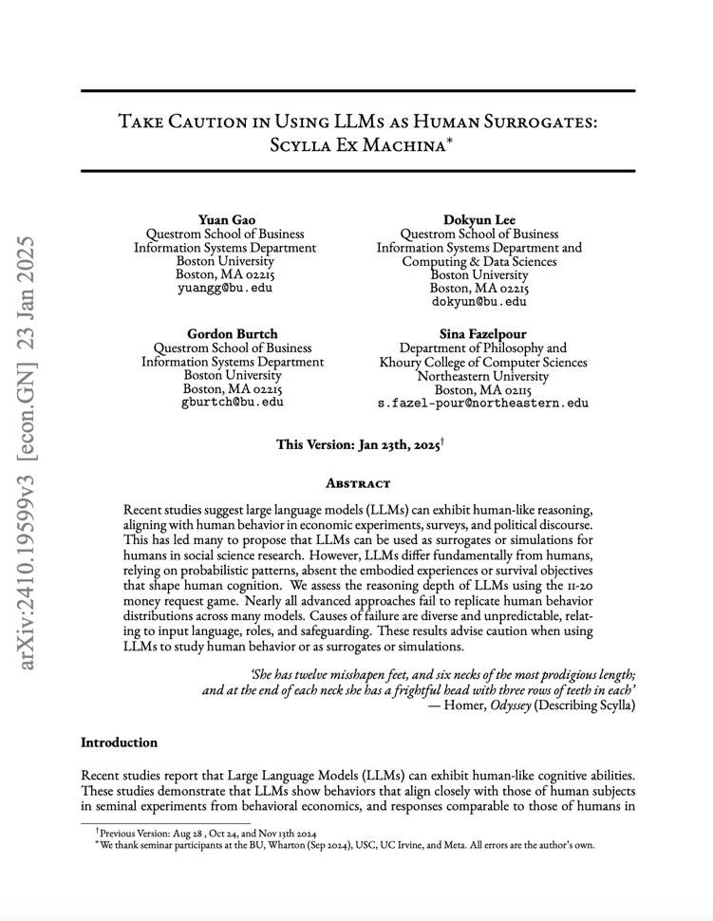
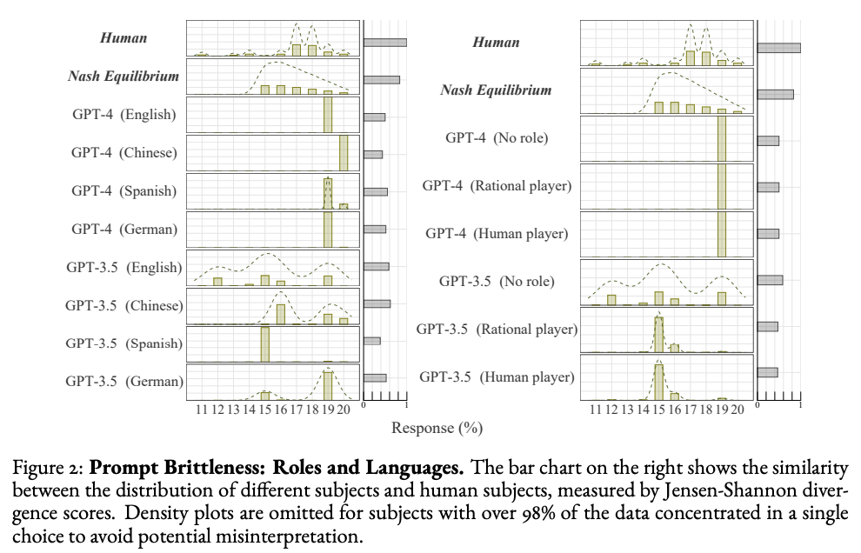
Some Research

Slide 6
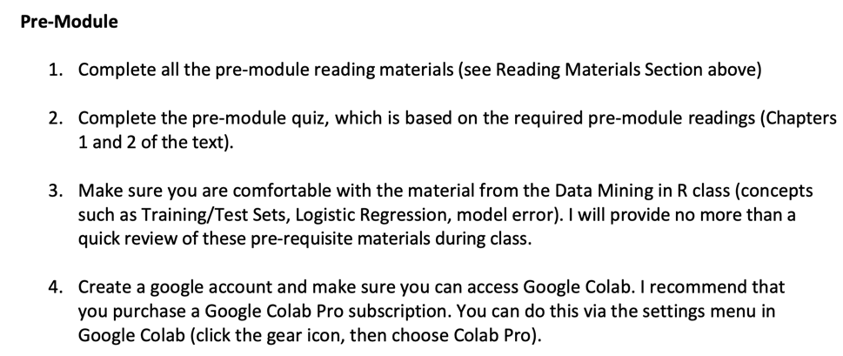
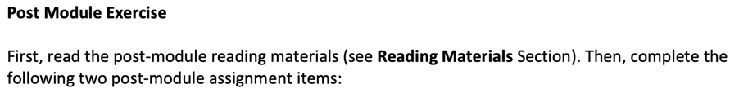
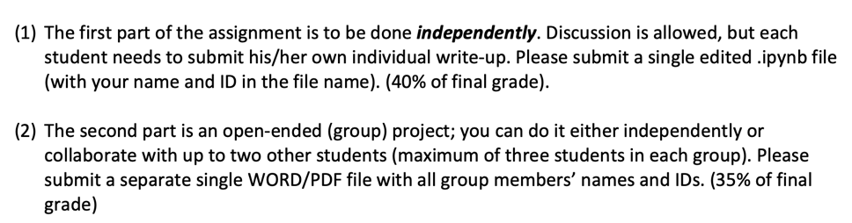
Grading & Evaluation
25%
40%
35%

Slide 7
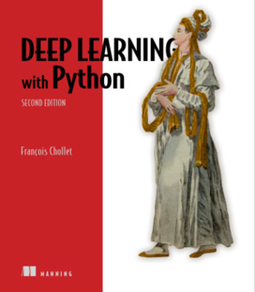
Course Textbook
Chollet, François. (2021). Deep Learning with Python (2nd Edition). Manning Publications Co. ISBN-13: 978-1617296864. https://www.manning.com/books/deep-learning-with-python- second-edition

Slide 8

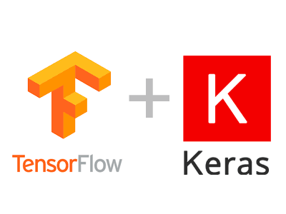


Required Software
SOFTWARE CONFIGURATION
You can access Google Colab at https://colab.research.google.com. You should have setup a colab account already.

Slide 9
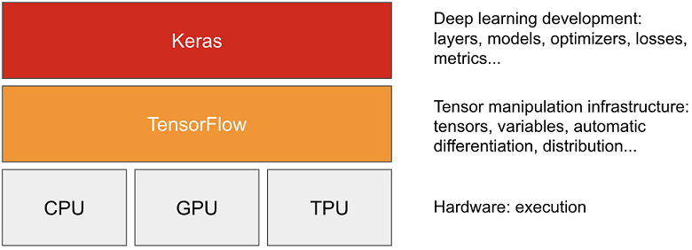
Keras and Tensorflow
1. Tensorflow
A Python platform for working with tensors, implementing automatic differentiation, providing access to repositories of (well-known) pre-trained models.
2. Keras
A higher-level API that wraps common usage patterns with Tensorflow functions, pre-defined loss functions, optimization algorithms, etc.
Keras simplifies data scientists’ interaction with Tensorflow.

Slide 10
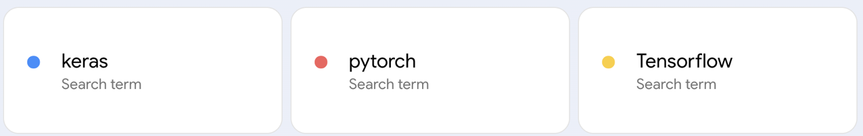
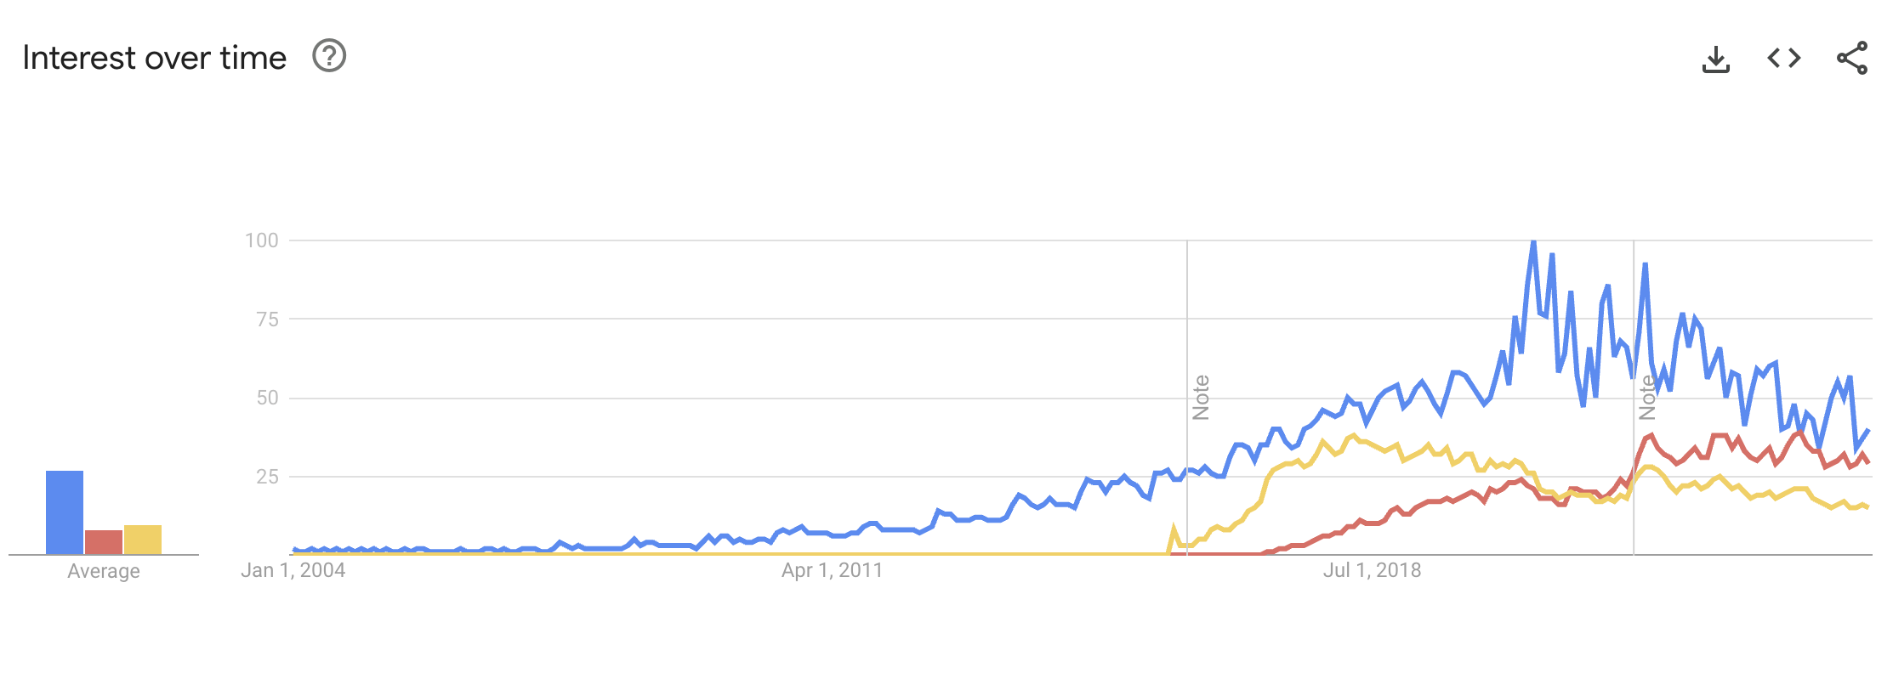
Why Keras?

Slide 11
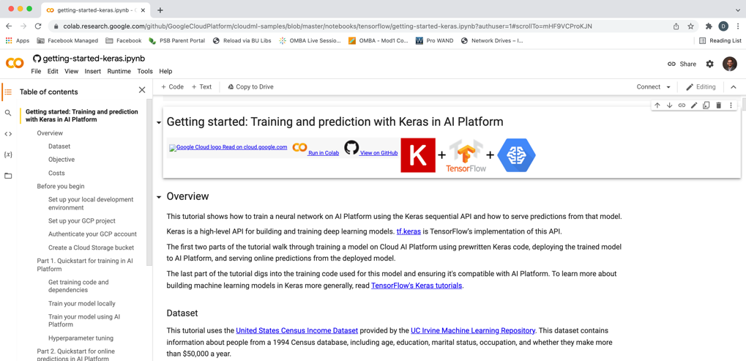
Google Colab

Slide 12

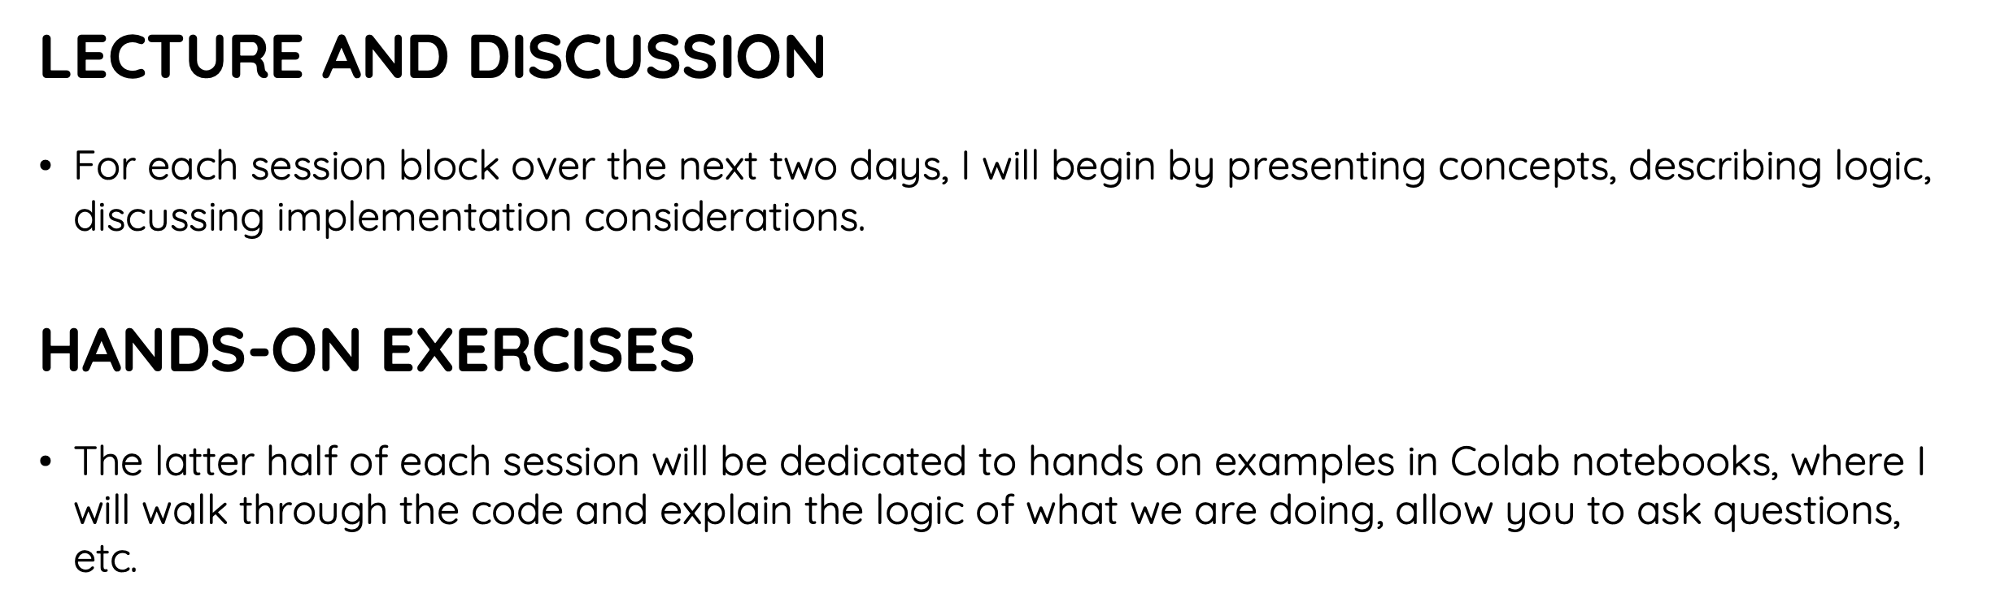
Course

Slide 13
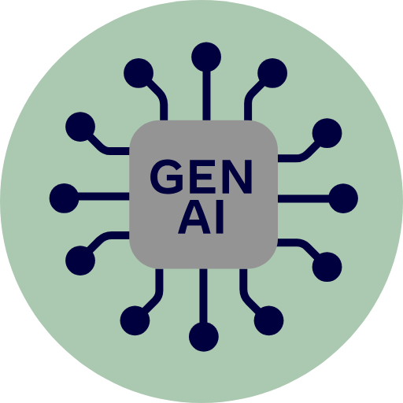
Support
USE IT TO HELP YOU LEARN AND PERFORM BASIC TASKS
I expect you to use these tools. However, the way you use them matters. Some valid use cases include …
Implementing data munging tasks that you might already understand based on past coursework, e.g., pre-processing text.
Automatic generation of code comments or documentation.
NOT TO GENERATE SOLUTIONS FROM SCRATCH
If you use these tools as a shortcut to avoid understanding the course material, you will not do well in this class. If we encounter functions and practices that were not taught in the course (e.g., PyTorch code), you will be asked to explain your code to us orally. If you are unable to explain what the code is doing, points will be deducted from your grade.

Slide 14
Any Questions?

Slide 15
What is ‘Deep’ (vs. Shallow) Learning?
https://chat.openai.com/chat
Notes:
Let’s ask ChatGPT!

Slide 16
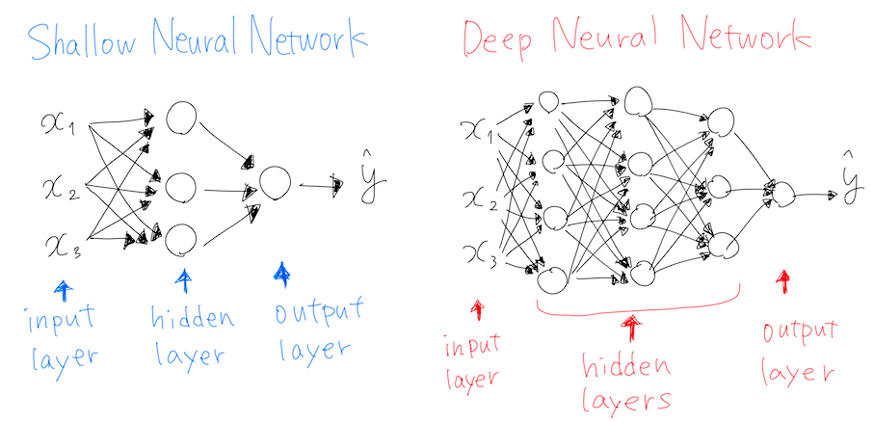
What is ‘Deep’ Learning?
Notes:
Most other ML approaches are shallow (they map inputs to outputs in a single layer / transformation, or few layers). Deep here refers to the fact that there is a layered approach to transformation. 4 or more layers, generally, by which transformations feed into other transformations, enabling flexible representation of mappings.

Slide 17
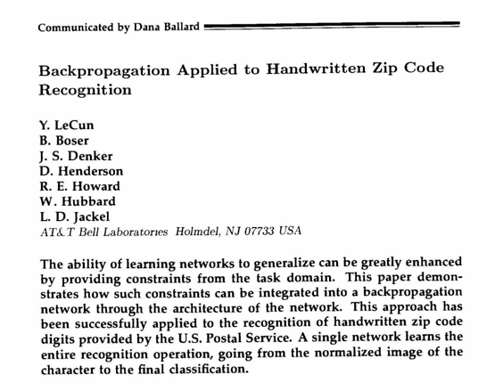
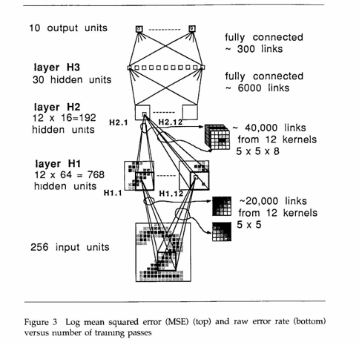
Where Deep Learning Started

Slide 18
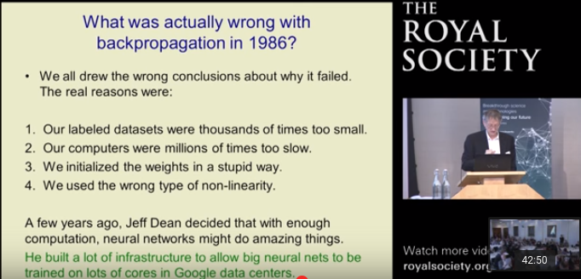
Then It Shuffled Along for Decades…
Now…
Notes:
Vanishing gradient problem,

Slide 19
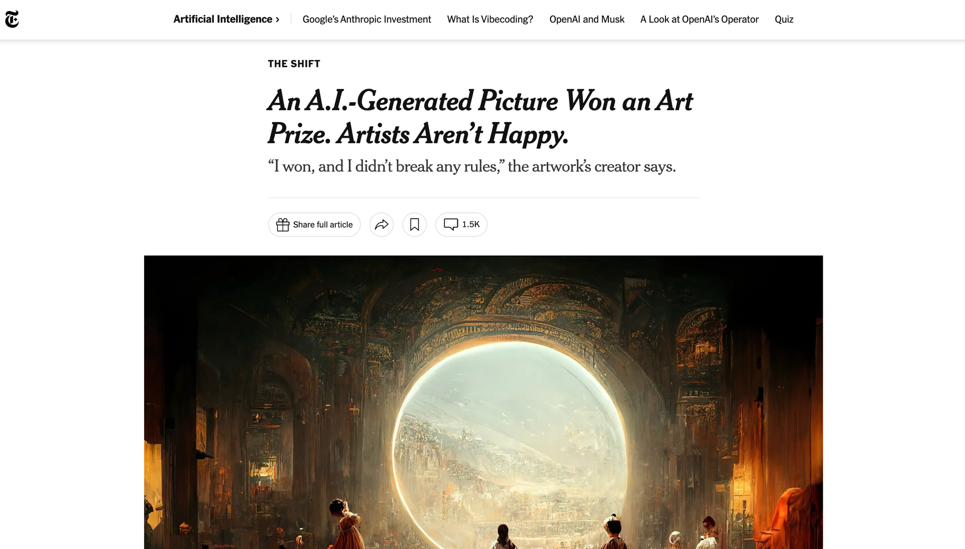

Slide 20
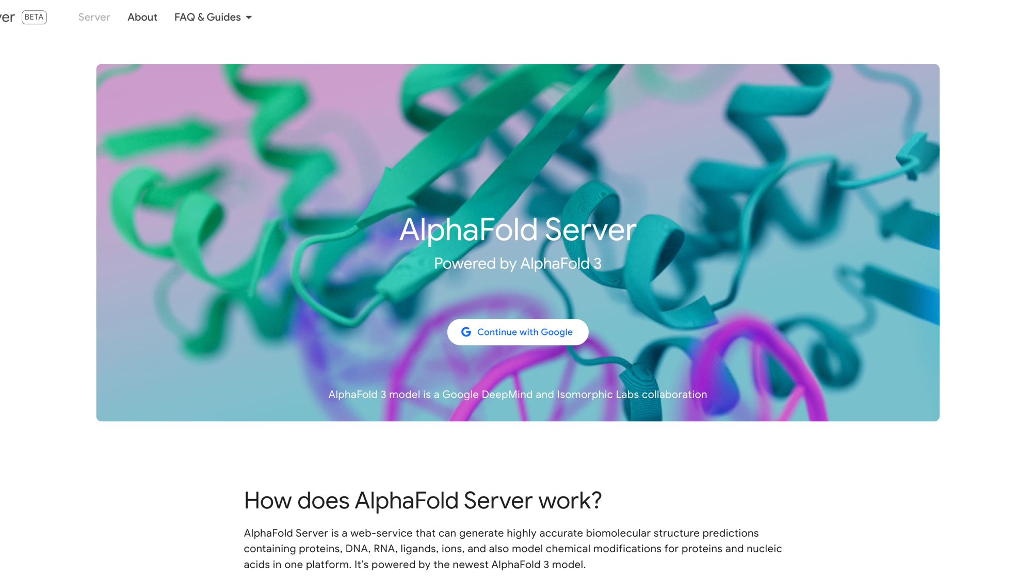

Slide 21
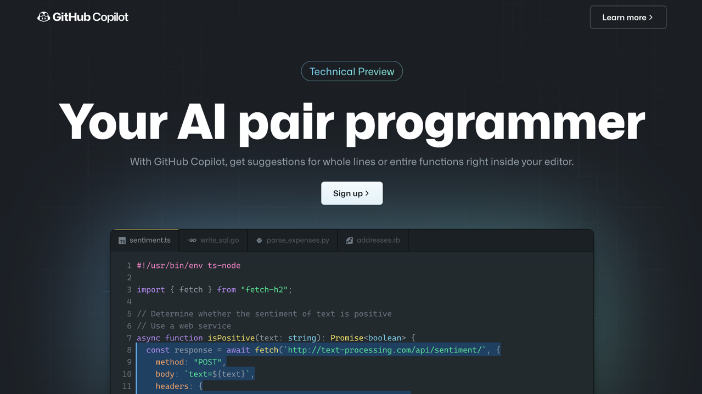

Slide 22


Slide 23


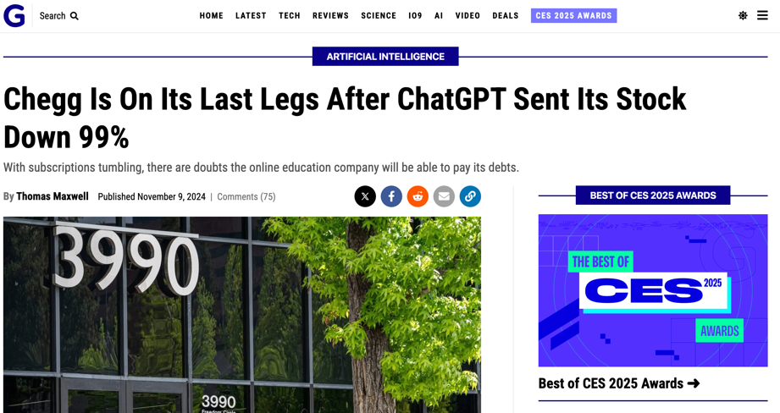
These Technologies Bring New Problems

Slide 24
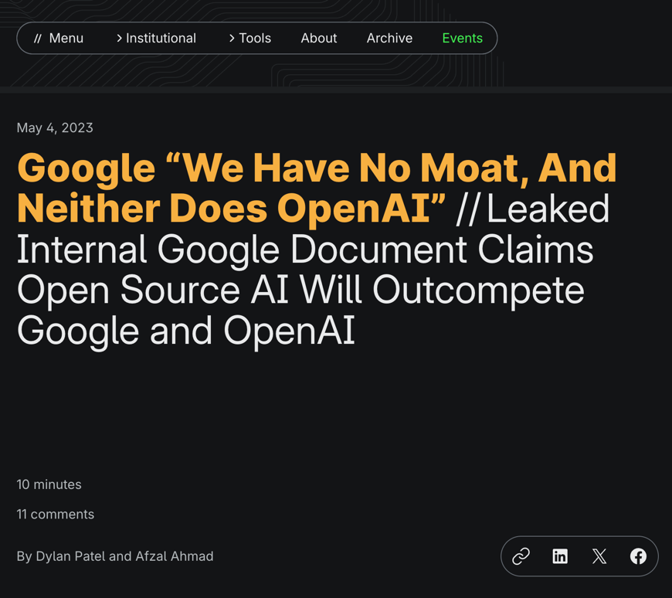
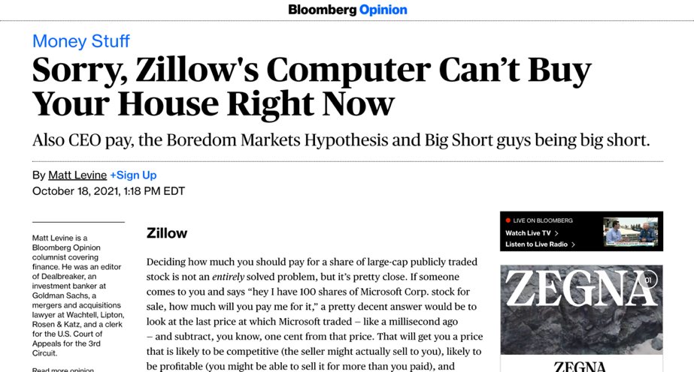
Business Process / Model Still Matters

Slide 25
How It Works, Conceptually

Slide 26
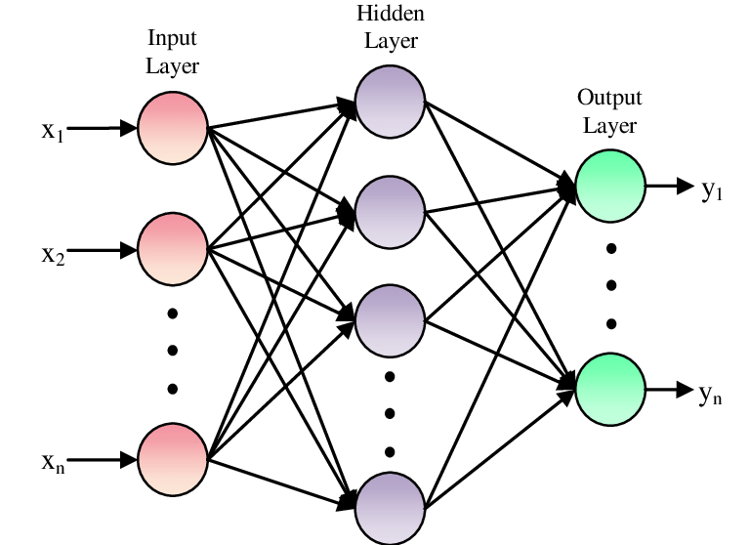
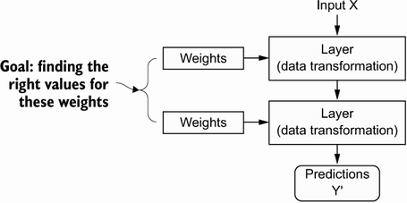
Model Parameters

Slide 27
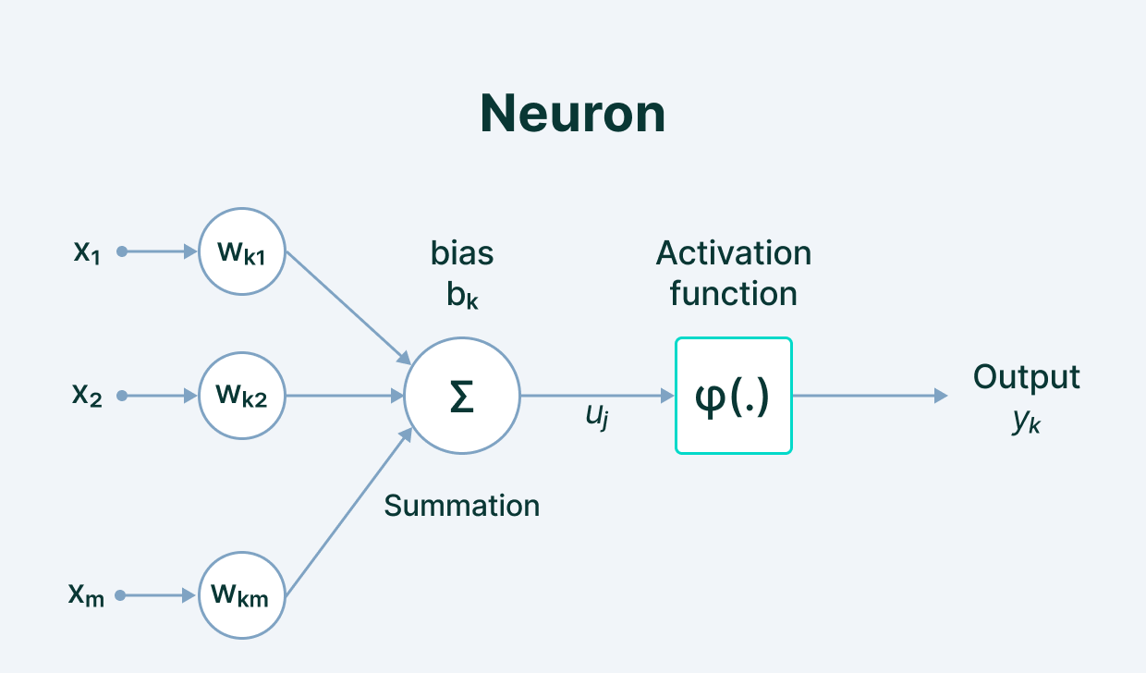
Model Parameters
Notes:
We define the network structure (layers / nodes / edges) and the activate functions (within each node). Our data, X and Y (inputs and labels) are given. Our goal is then to “learn” the remaining parameters, i.e., the w’s and b’s.

Slide 28
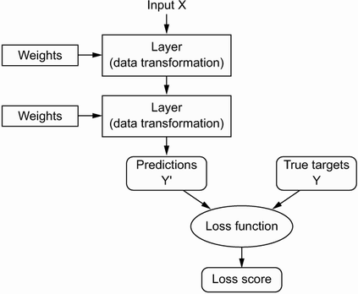
Loss Function (Error)
Notes:
How do we learn the parameters? We need a way to quantify how well we are doing. This is what the loss function is for; it informs our optimization about how ”optimal” our current set of parameter values is.

Slide 29
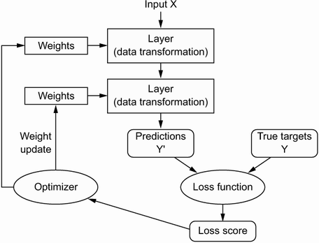
Optimization
Notes:
How do we implement the learning (optimization)? Gradient descent. We identify where we are on the loss curve, figure out a first derivative along all available dimensions (i.e., along all parameters), and proceed where the gradient is most negative (i.e., where the loss function progresses most rapidly toward zero. For this to work, we need to be able to figure out the gradient along each dimension (for each parameter) in a computationally efficient way (remember, some of the biggest models have thousands or millions of parameters!).

Slide 30
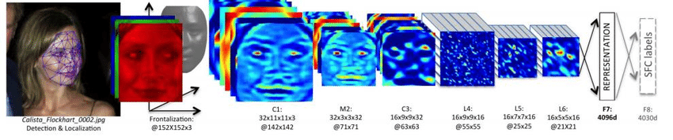
When to Learn Deeply (vs. Not)
COMPLEX RELATIONSHIPS
Complex, non-linear, interactive relationships and mappings; common use cases involve unstructured (high dimensional) data. Deep learning techniques remove the need for feature engineering, a daunting task.

Slide 31
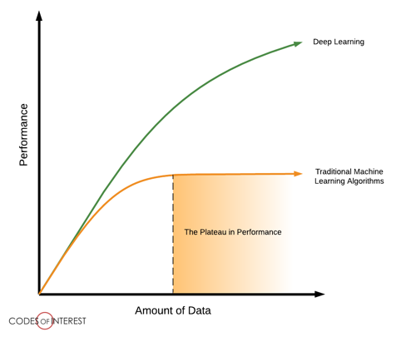
When to Learn Deeply (vs. Not)
LOTS OF DATA ON HAND
To be able to learn those complex mappings, typically requires many, many, many training examples.

Slide 32
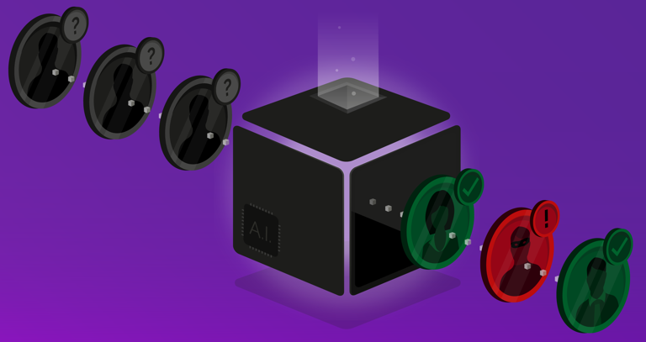
When to Learn Deeply (vs. Not)
LITTLE NEED FOR UNDERSTANDING
Although there have been advancements in explainable and interpretable AI, deep nets are notoriously “black box” algorithms.

Slide 33
Why Did Deep Learning Take Off?

Slide 34

Video Games
Notes:
GPUs were developed to handle parallel processing capabilities needed for high end video game graphics. Turns out those same designs were useful for training a neural net (parallel computation, through vectorization of code). Basically, training a deep net involves performing a shitload of matrix multiplications. It’s better if we can do those calculations in parallel rather than sequentially. GPUs (and now TPUs) enable a ton of parallelization, speeding up the calculations.

Slide 35
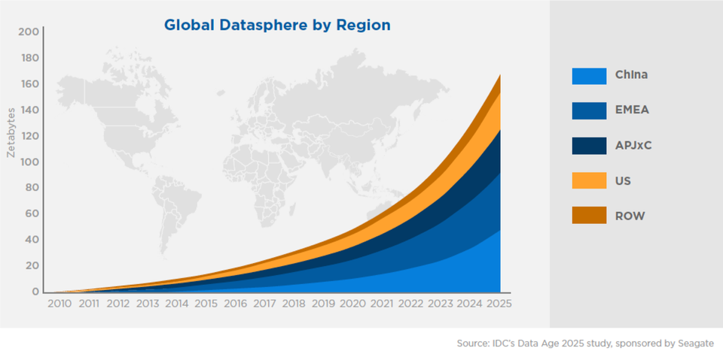
Data

Slide 36
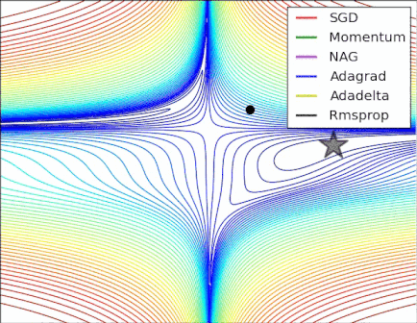
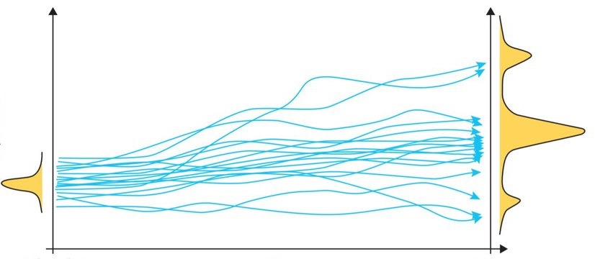
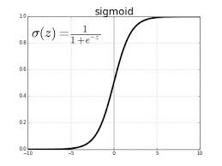
Algorithmic Improvements

Slide 37
Questions?

